Slide 1
OMEDI NLP
Voice Assistant
Morphological Based Voice Assistant

Slide 2
About OMEDI NLP Voice Assistant
This is an application which makes people lives more comfortable and easy. This voice assistant can make some user requirements like search something on the web and talk with a wisdom(Chatbot) and manage some phone and desktop applications.

Slide 3
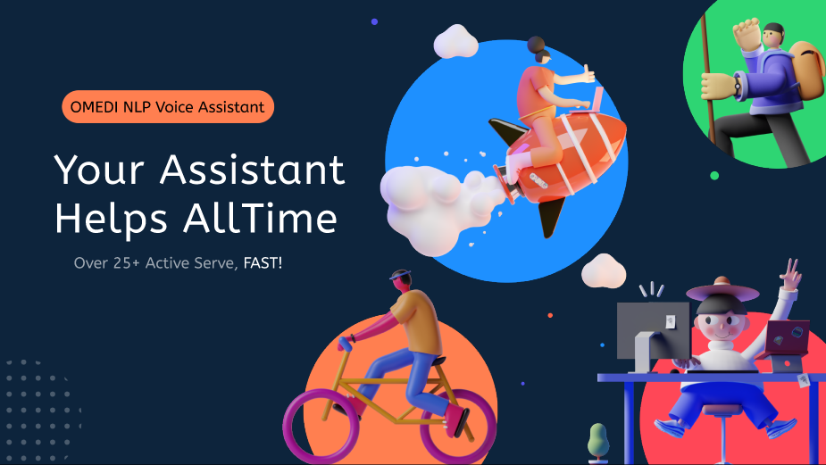
Kullanıcı deneyimi
Fiziksel Bilişim

Slide 4
UI Design

Slide 5


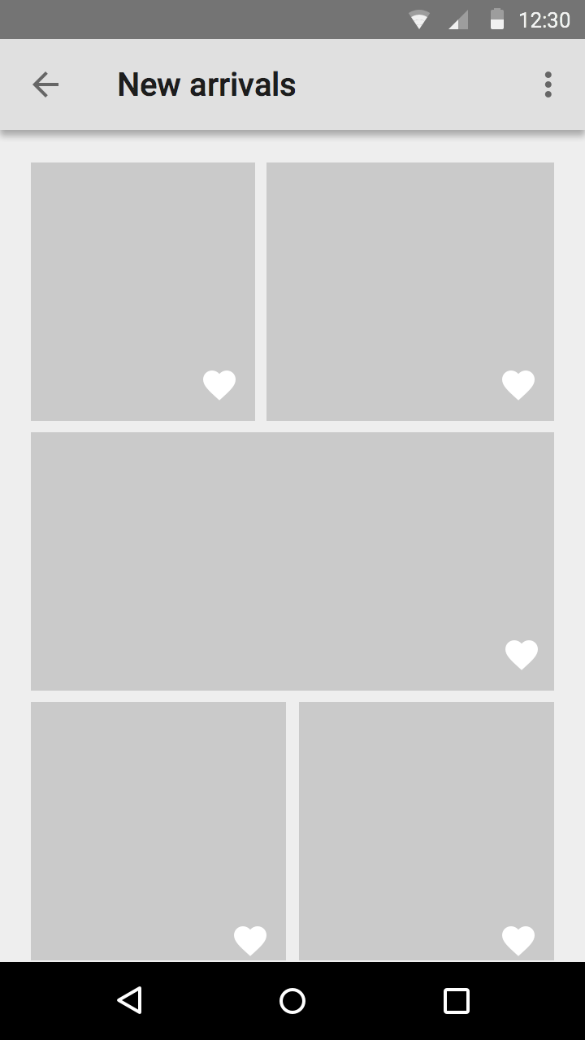
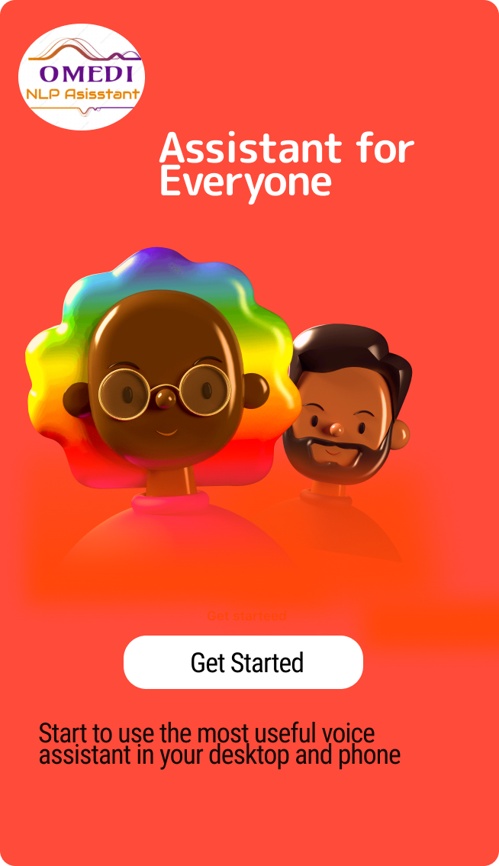
OMEDI Voice Assistant
In this page user can enter the system and when user enter it as shown for desktop and mobile. Assistant will start to ask some questions to user.

Slide 6
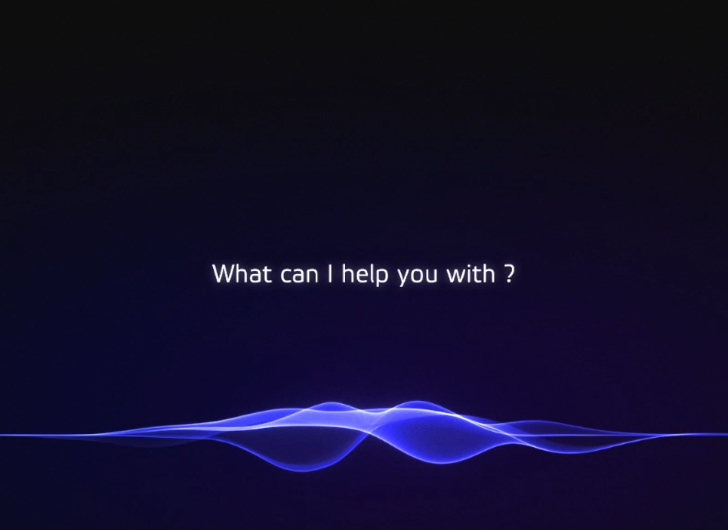
Assistant will ask question user. There are few options like search on the internet, or manage apps

Slide 7





If user wants to search
If user wants manage apps
If user wants to search something on the internet, program will search for user and it will present pages for user with audio or just pages.
If user wants to manage apps like music player or any application on device it will work.

Slide 8


Examples for searches

Slide 9
This assistant application will not work as a main window app. It will be always active and when user call it like hey assistant It will work. Also in social media or mail chats OMEDI Voice Assistant will hep user about sending files, voice messages, media messages or call other device owners.

Slide 10

Chat Management

Slide 11
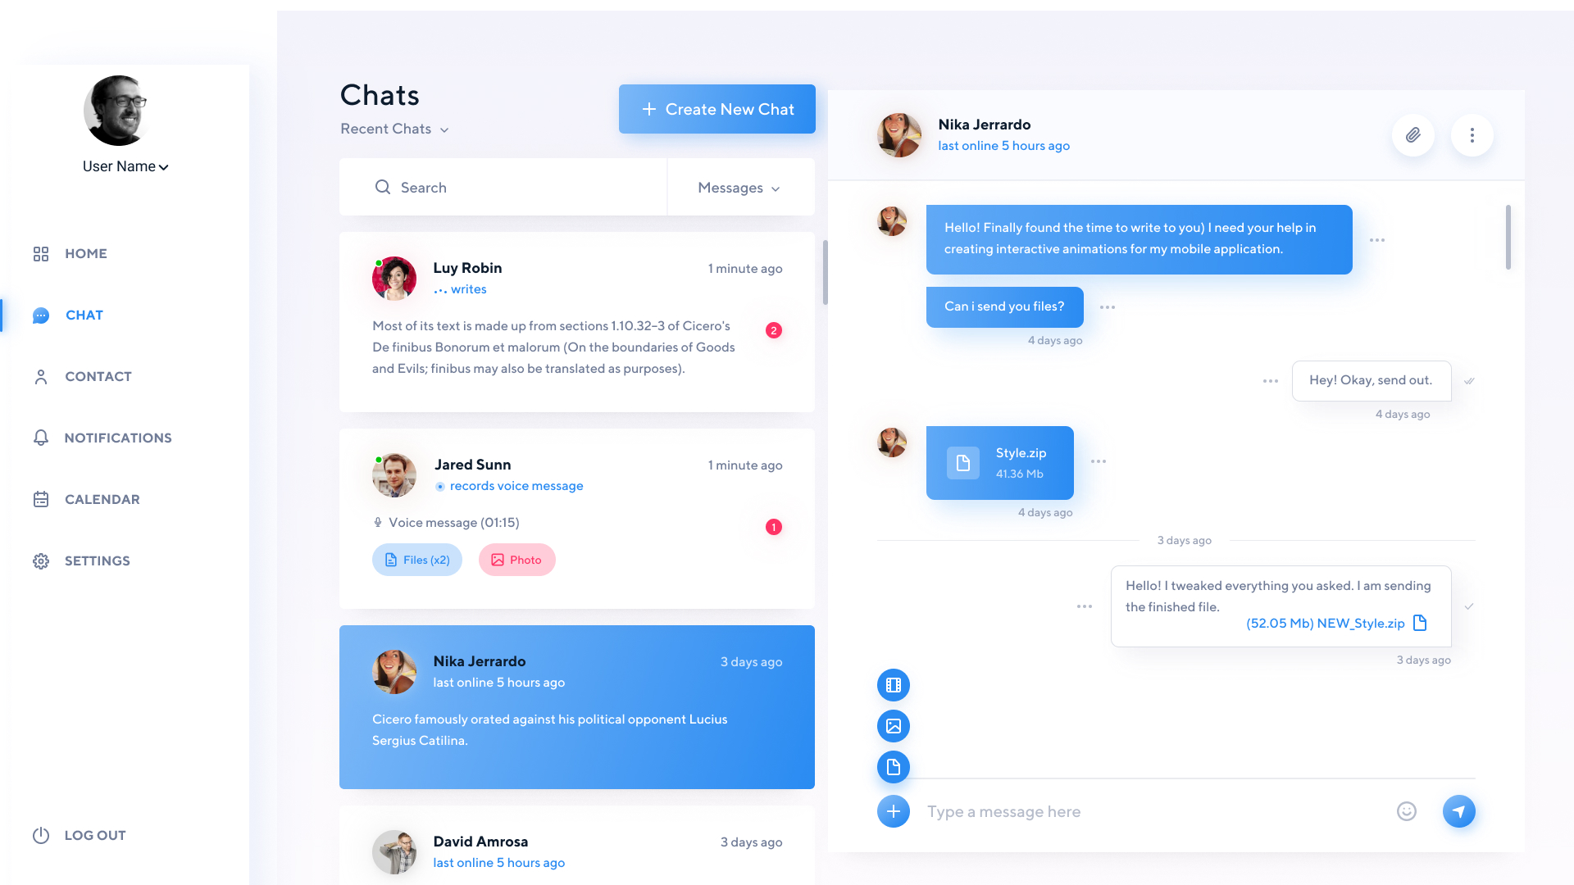

Slide 12
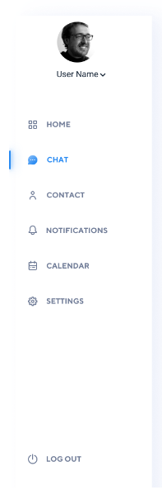
With this part of chat management. User will administrate user panel.
Log in and Log out
Search for user preferences

Slide 13
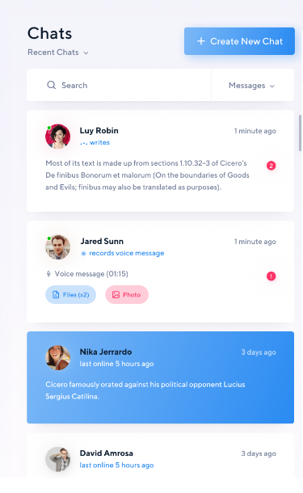
With this part of chat management. User will see and control contacts.
Contact list
Recently talks

Slide 14
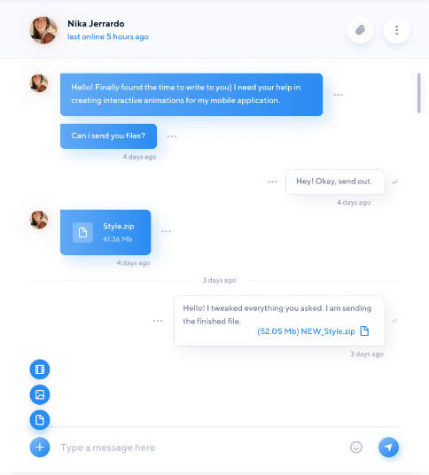
With this part of chat management. User will talk with contacts.
Sending few type of messages
Call
Displaying chat screen

Slide 15



As shown in UI slide show Voice Assistant app will make some operations for users to make their daily lives more comfortable.

Slide 16

OMEDI NLP Voice Assistant
Osman Melih TOLUNAY
Dilan KAYA
Umut ŞENTÜRK
Mustafa KÖRÜKMEZ

